Slide 1
Blog 網頁設計
資工二 107590058 陳小蘭

Slide 2
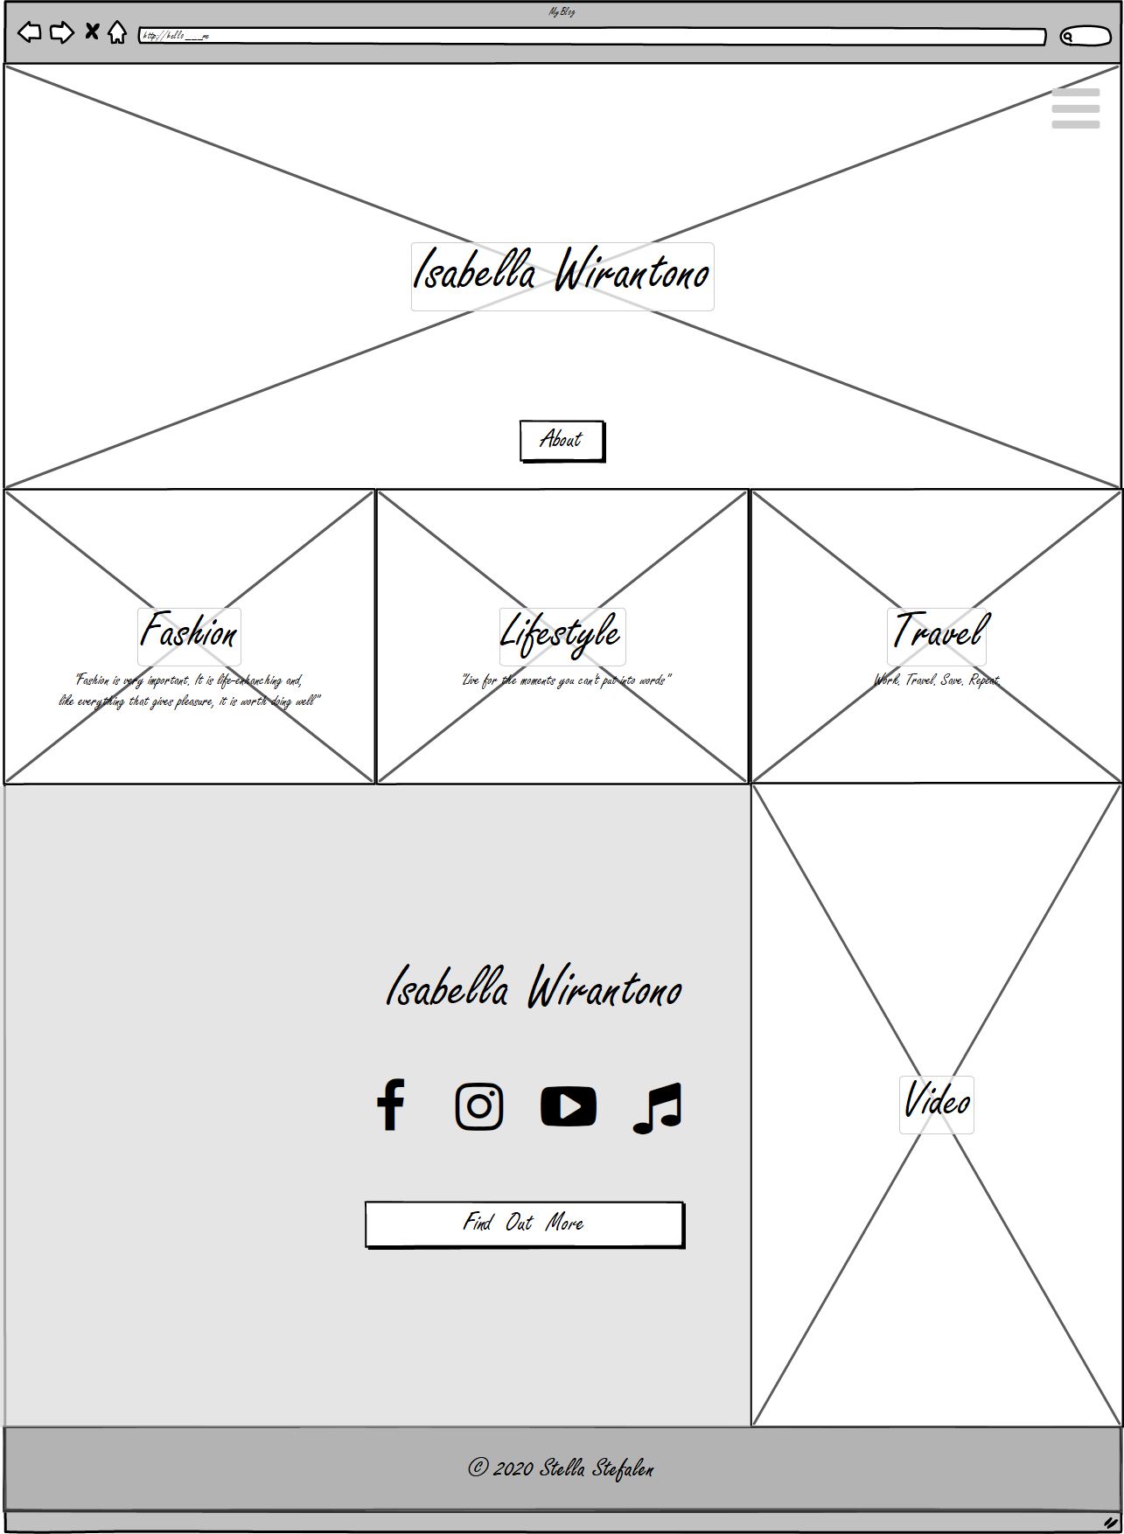
Menu button on the top-right (contain : About, Fashion, Life-Style, Travel)
About Button
3 picture link to Fashion, Life-Style and Travel page
All Social Media button
“Fund Out More” button link to About page
Video link to TikTok Account
Footer

Slide 3
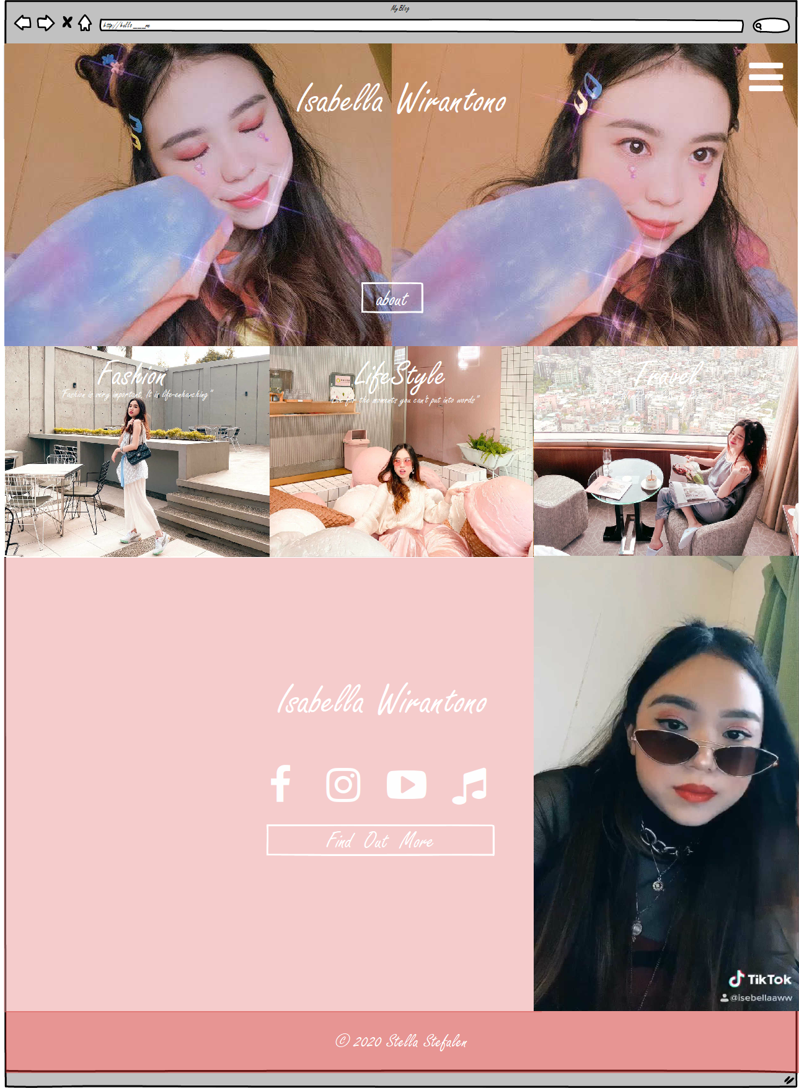
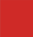

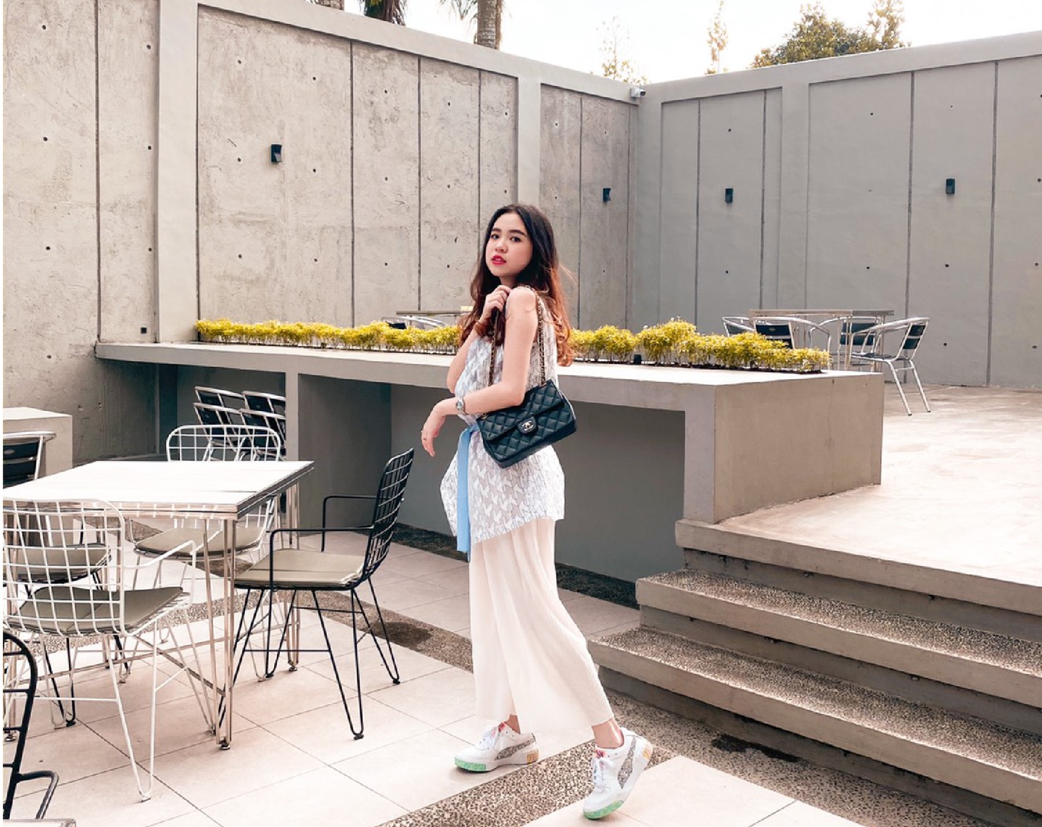
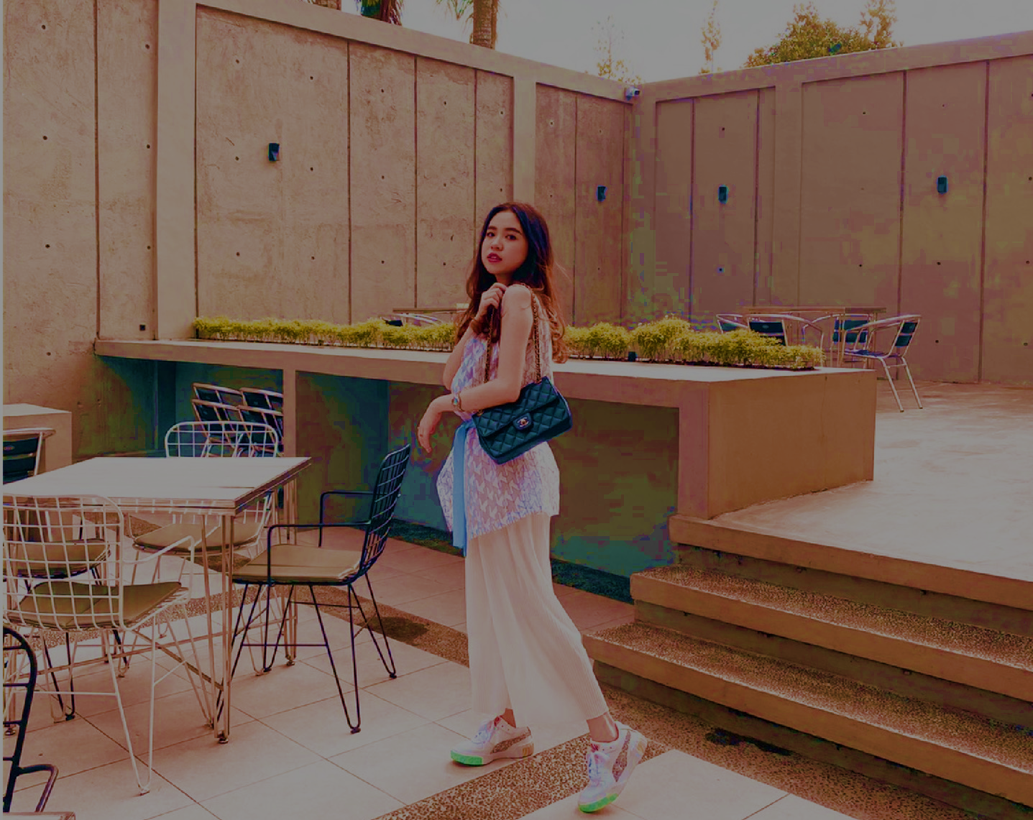
Color
red (cf2a27), Opacity 50%
Red interpret ‘passion’ , ‘desire’ and ‘love’ . It’s a very emotional color and show feminismness. Suit the character of the Person on the Blog.
red2 (ea9999), Opacity 50%
2. Visual Regression
3. Font
Button
Freestyle Script 40px
Title
Freestyle Script 72px
Menu Font
Freestyle Script 60px
Description
Freestyle Script 20px
Normal
Hover
Normal
Hover

